Slide 1
以遊玩特徵為導向的 程序化內容生成方法
Advisor: Prof. Wen-Kai Tai
Student: Ze-Hao Wang

Slide 2
Agenda
Introduction
Related Works
Mission / Space framework
Map Sketches & Evolution of Segments
Proposed Methodologies
System Architecture
Mission Grammars
Room Definitions and Instruction
Genetic Algorithm in Segments Evolution
Experimental Results
Conclusions and Contributions
Future work

Slide 3
Introduction

Slide 4
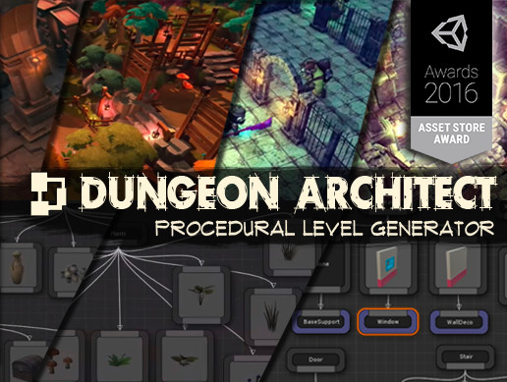
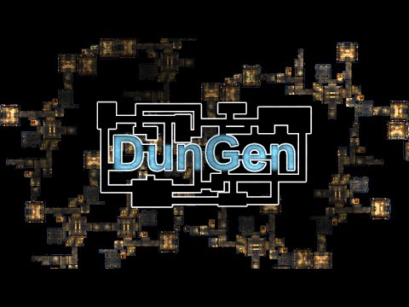
Motivation
[會再翻成英文]
程序化內容自動生成 (Procedural Content Generation) 在過去就廣泛被應用於遊戲設計領域，其主要目的為增加遊戲內容的隨機性與多樣性。我們預期讓玩家在進行遊戲時能夠遵循關卡設計師的劇情脈絡外，亦能夠體驗到有意義且多樣化的遊戲關卡內容。

Slide 5
Research Goals
[會再翻成英文]
我們針對遊戲過程中的遊玩特徵 (gameplay patterns) 進行抽象化，使用程序化生成技術產生帶有意義遊戲關卡內容，藉此消彌或降低因隨機性所產生的不穩定要素，以改善並豐富遊戲體驗。

Slide 6
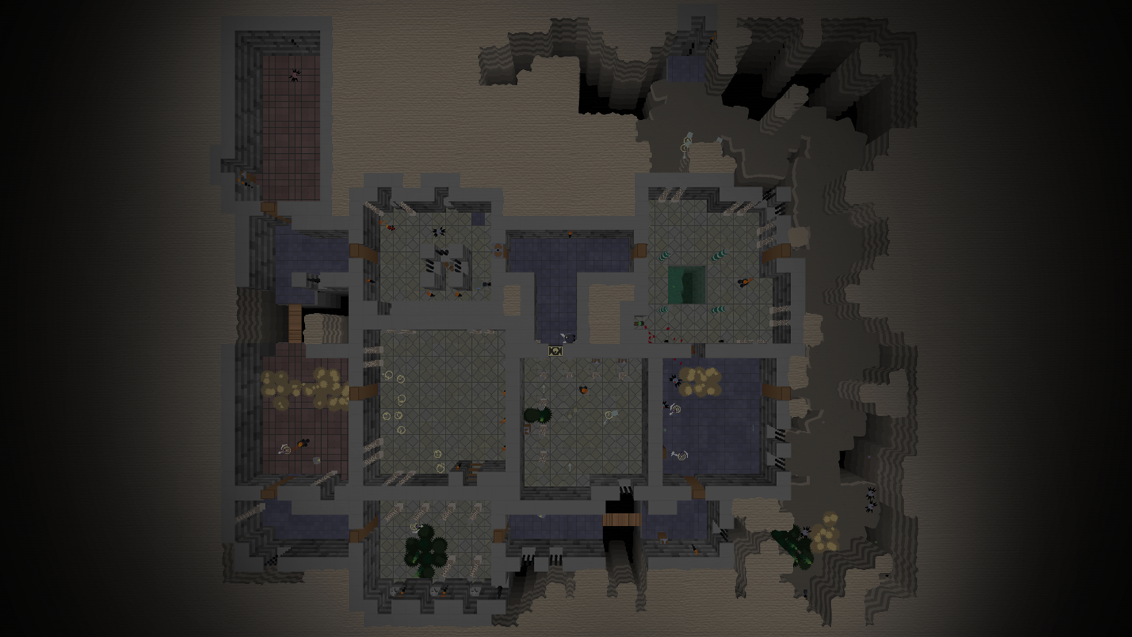
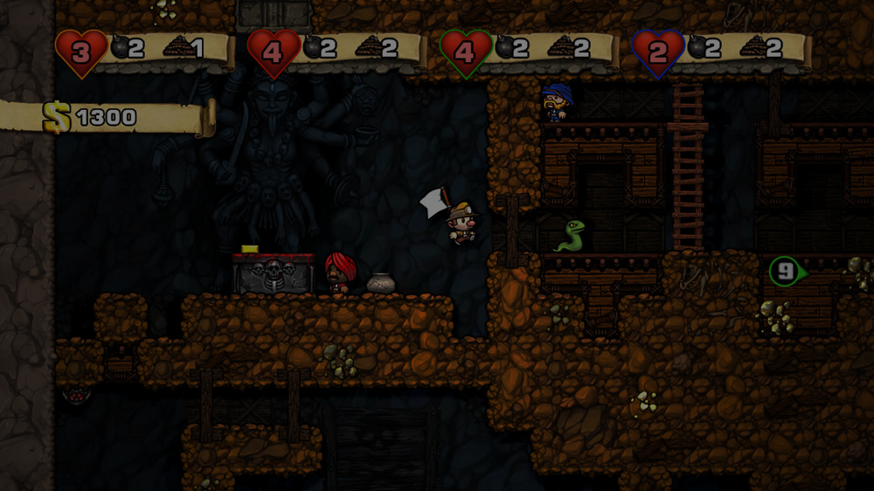
Related Works
Mission / Space framework
Map Sketches & Evolution of Segments

Slide 7
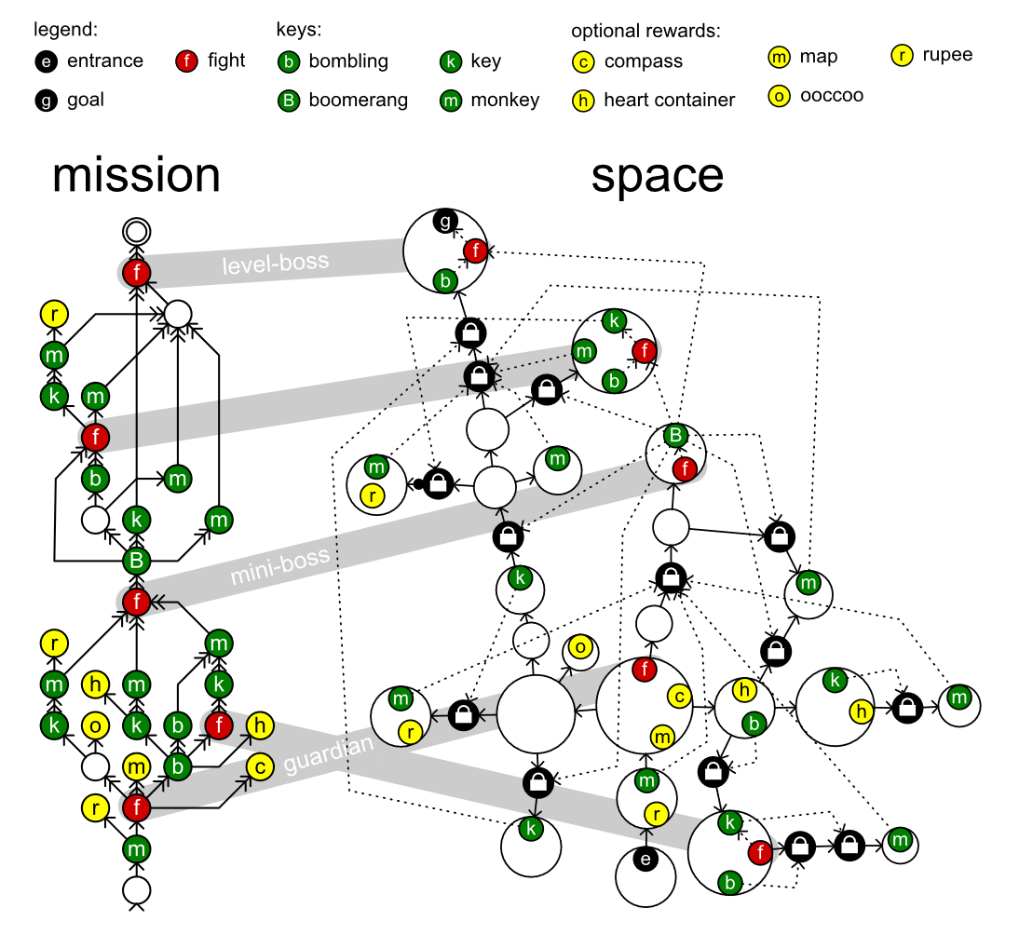
Mission / Space framework
Mission/Space framework, focuses on level design and the mechanics that control player progression through a game.
Transformational Grammars
Mission Grammars
Space Grammars
Mission Graph Convert into Space Graph

Slide 8
Transformational Grammars
Be consisted from an alphabet and a set of rules
Alphabet It is a set of symbols the grammar works with.
Set of rules It specifies what symbol can be replaced by what other symbols to form a new string.
Sides and symbols of the rule
Terminals (common in lowercase) Symbols in the alphabet can never be replaced because there are no rules.
Non-terminals (common in uppercase) Symbols have rules that specify their replacement.
S → ab
Symbol
Symbol
Symbol
{ S, a, b } is an alphabet

Slide 9

Mission Grammars
Inhibitions
Available when at least one of the weak prerequisites is completed.
Strong requirement
Available when all strong prerequisites are completed.
Weak requirement
Available when at least one of the weak prerequisites is completed.
Example of mission graph
Mission graphs represent the players’ progress towards a goal not by tracking their physical location, but by tracking the tasks they must perform to finish a level.
A mission graph is a directed graph that represents a sort of to-do list with each node representing a task that might or must be executed by the players.

Slide 10
Space Grammars
k
t
g
t
k
e

Slide 11
Mission Graph Convert into Space Graph
The steps in the generation progress investigated in this paper in detail:
An alternative method, does not go into detail:
Mission
Map
Space
Refine
Level
Create
Space
Distill
Mission
Adjust
Space
Refine
Level
Create

Slide 12
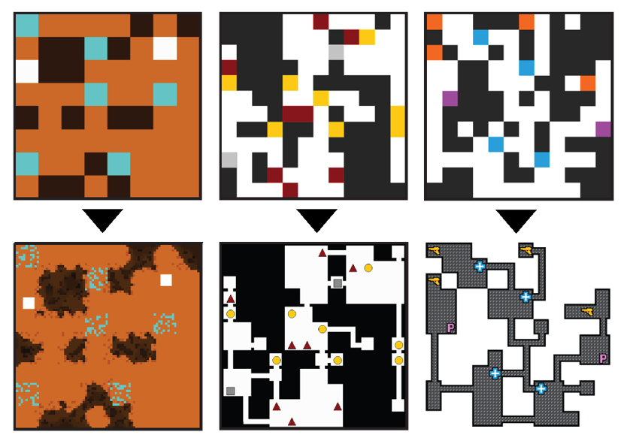
Map Sketches & Evolution of Segments
.
Map Sketches
Map Sketch Evolution
Dungeon Segments
Dungeon Segment Evolution

Slide 13
Map Sketches

Slide 14
Map Sketch Evolution

Slide 15
Dungeon Segments

Slide 16
Dungeon Segment Evolution

Slide 17
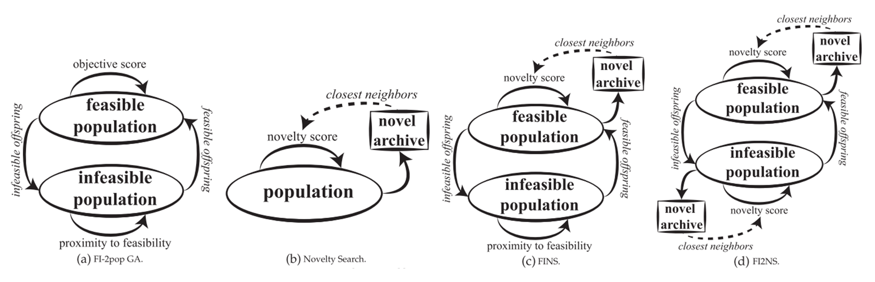
Constrained Novelty Search

Slide 18
Proposed Methodologies

Slide 19

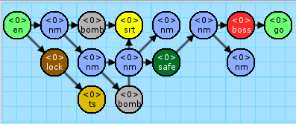


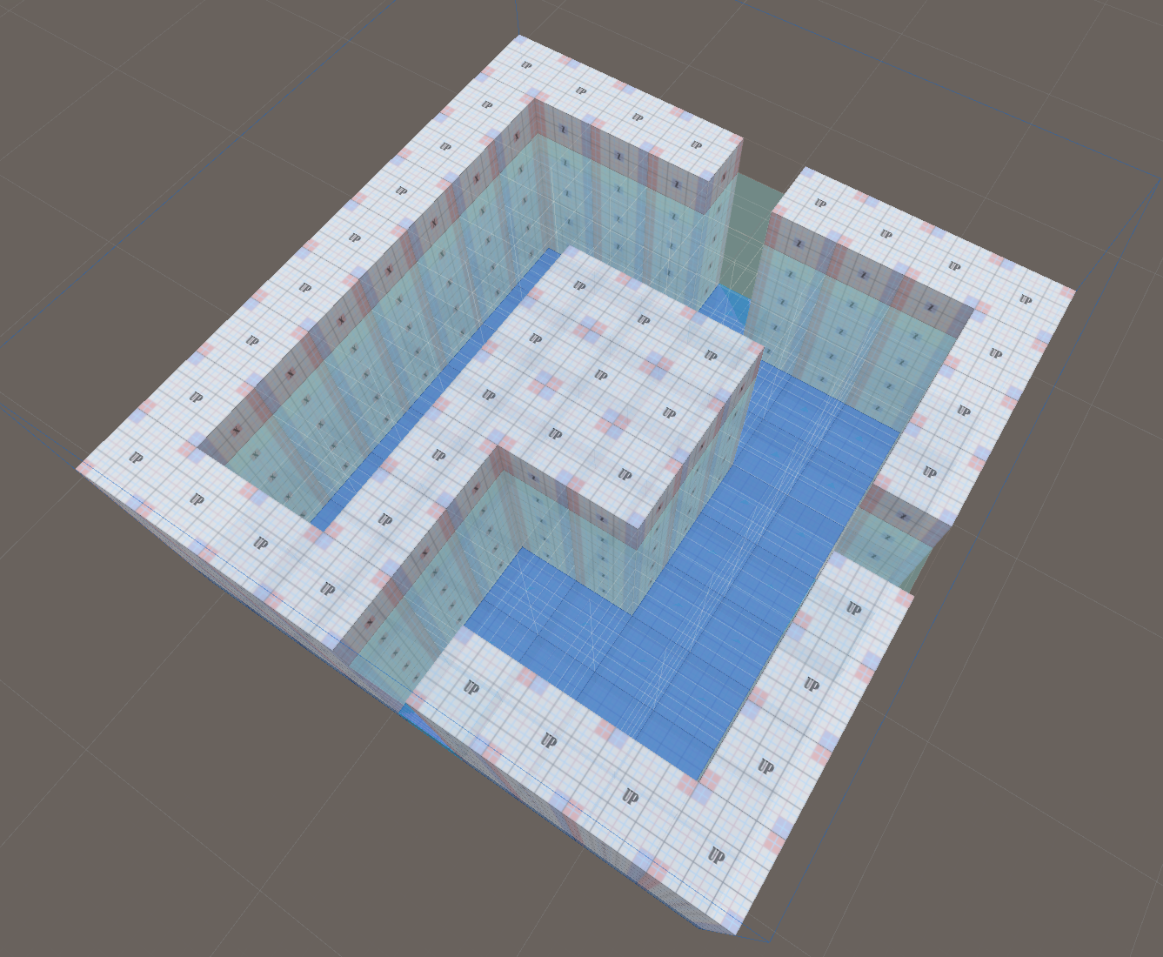
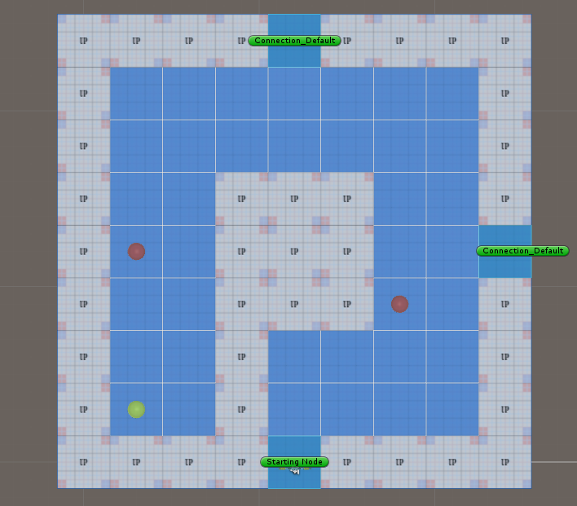
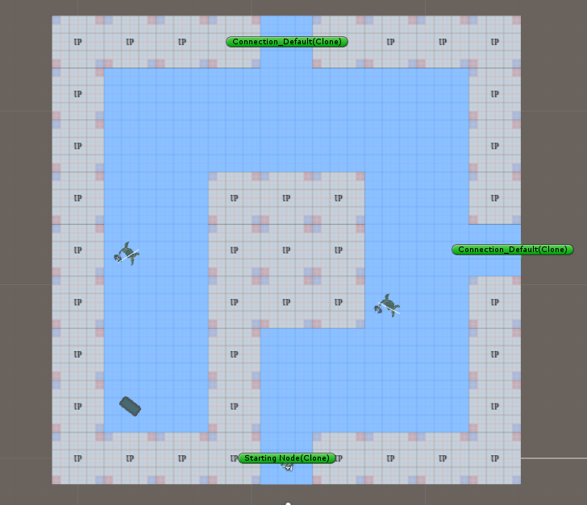
System Architecture
- Phase 1 - Mission / Space framework
- Phase 2 - Dungeon Segment Evolution
圖片 需更換

Slide 20
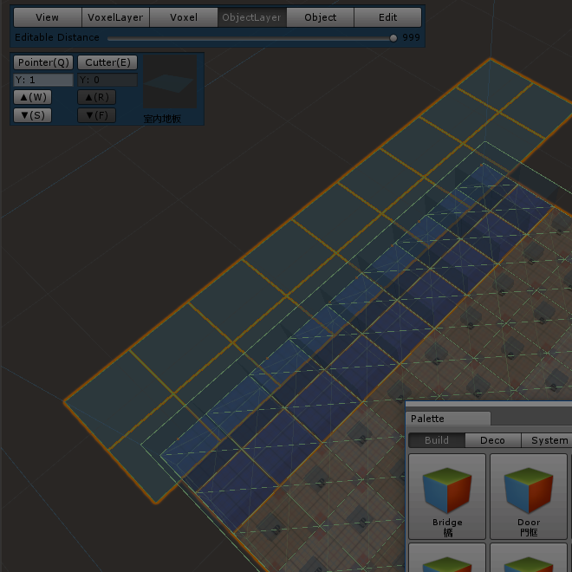
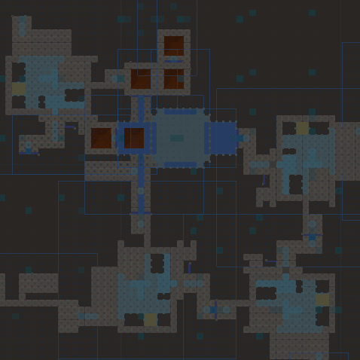
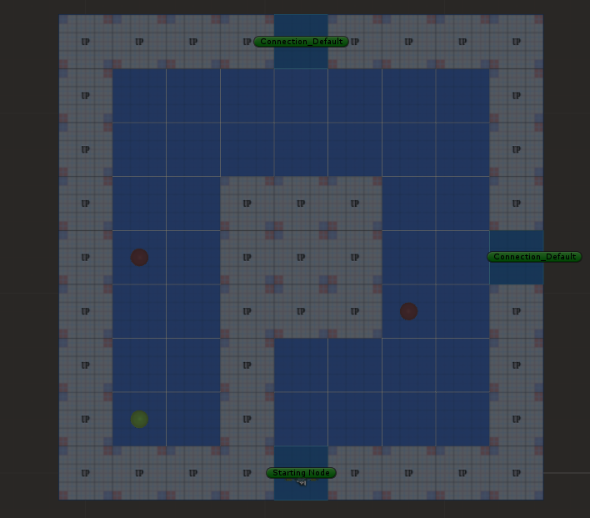
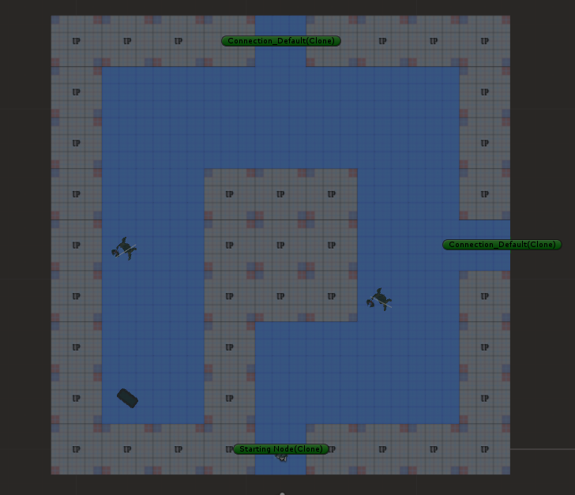
System Architecture
1. Create Mission Grammars
Mission Alphabet
Terminal nodes & non-terminal nodes
Mission Rules
圖片 需更換

Slide 21
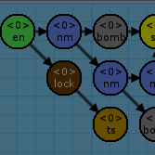

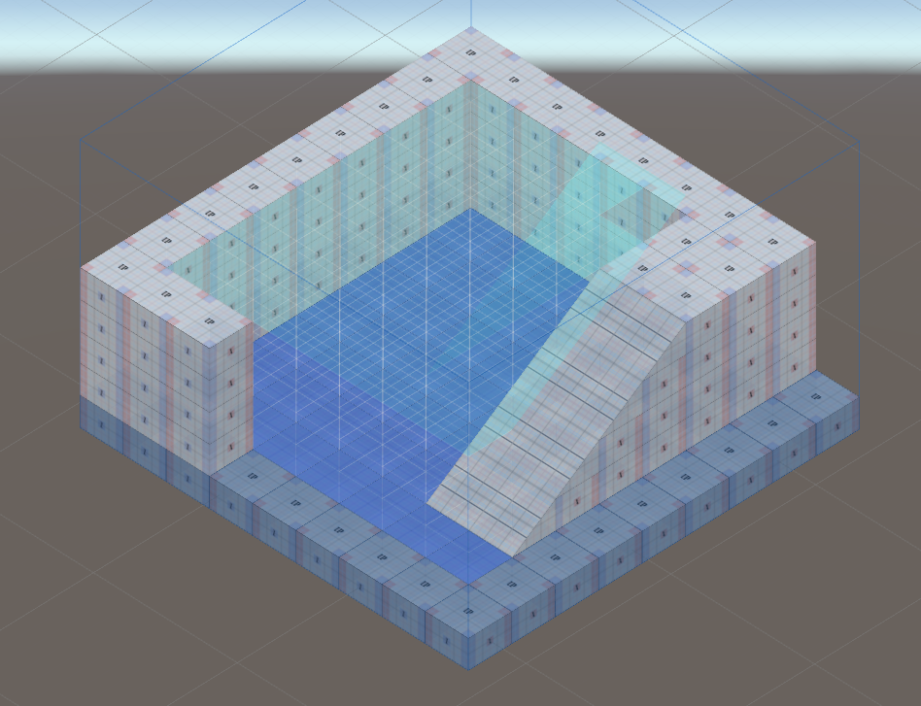
System Architecture
2. Create Volumes
Volex-based volumes
圖片 需更換

Slide 22
System Architecture
3. Generate the Space
Instruction of Rewrite System
Replacement of Rewrite System
圖片 需更換

Slide 23


System Architecture
4. Generate the Game Patterns
Genetic Algorithm for emergence objects
Nine main metrics to design the fitness functions
圖片 需更換

Slide 24
System Architecture
圖片需更換 為各結果圖
圖片 需更換

Slide 25
System DEMO
影片將會放置於此

Slide 26
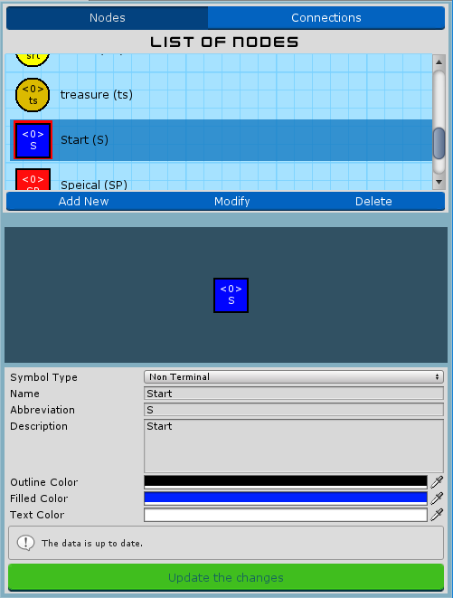
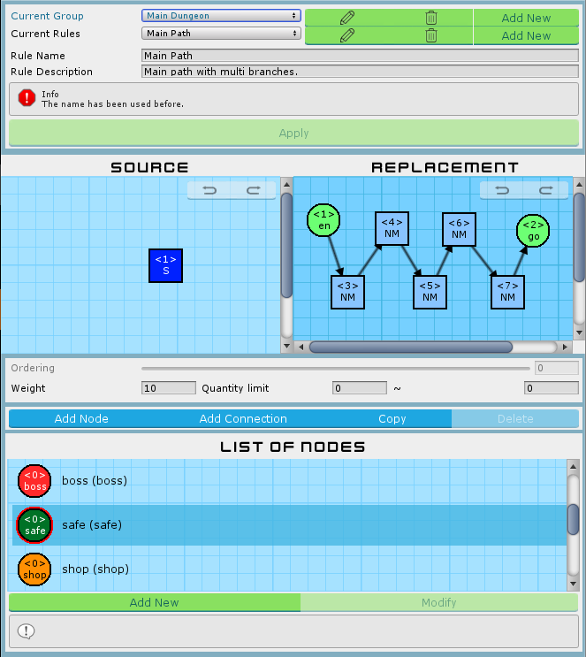
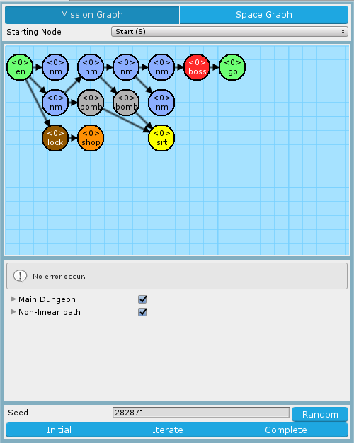
Mission Grammars
Mission Alphabet
Mission Rules
Mission Graph

Slide 27

Introduction of Mission Alphabet
List of symbols
Nodes and connections
Directly preview before selected
Preview area
Preview the symbol after editing immediately
Submit hint and form validations
Default and extended nodes
Default: None, Entrance, Goal
Extended: Any
Mission Alphabet Window

Slide 28
Introduction of Mission Rules
Hierarchy structure
Groups > Rules > Source & Replacement
Friendly interface to create, delete and edit.
Rule canvas
Drag & drop to modify symbols
Custom size of canvas
Selected symbol highlighting
Connections stick on nodes automatically
Back trace the states (Redo / Undo)
Mission Rules Window

Slide 29
Introduction of Mission Graph
Set starting node
The head of the mission graph
Preview mission graph
Rewrite system
Based on the mission grammar previous window set
Toggle the selectable rules
Find the match parts in graph with rules
VF Graph Isomorphism Algorithm
Mission Graph Window

Slide 30
Usage flow
A
Create the Mission Alphabet

Slide 31
Usage flow
B
Design the Mission Rules

Slide 32
Usage flow
C
Export the Mission Graph

Slide 33
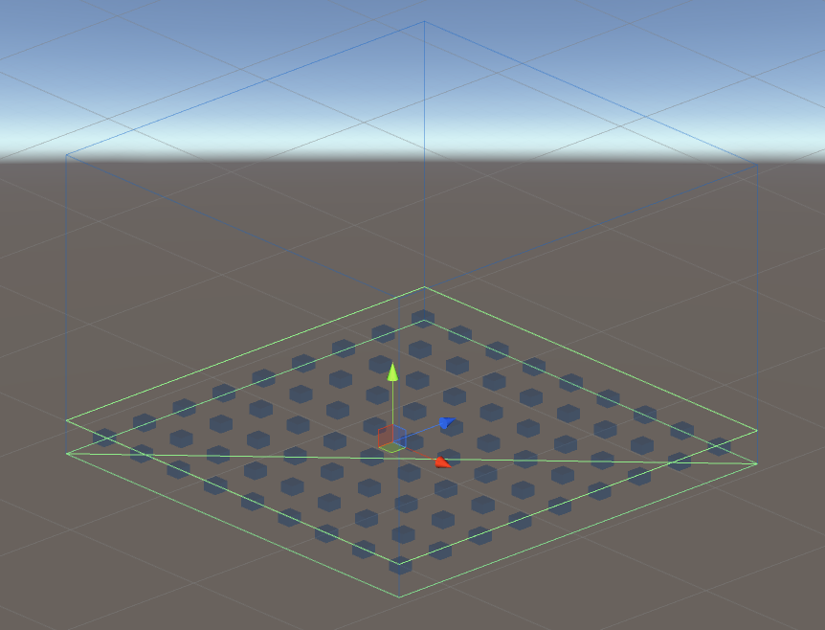
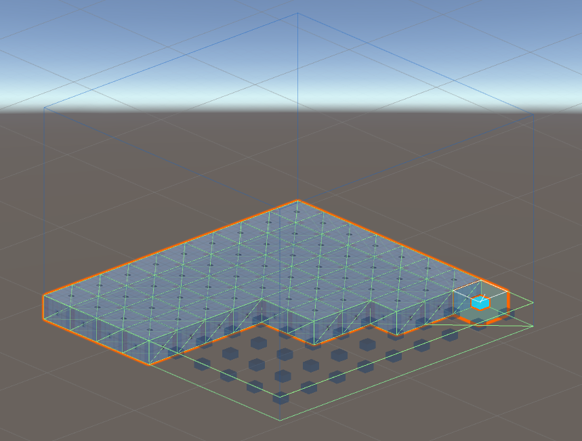
Room Definitions and Instruction
Editor
Voxel-based units
Markers I - Decorations
Markers II - Connections
Rewrite System
Instruction
Replacement

Slide 34
Voxel-based units in Editor
Hierarchy
Level A set of volumes. Express a complete game level.
Volume Volume has
Chunk
Voxel

Slide 35
Decorations in Editor

Slide 36
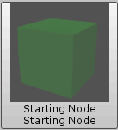
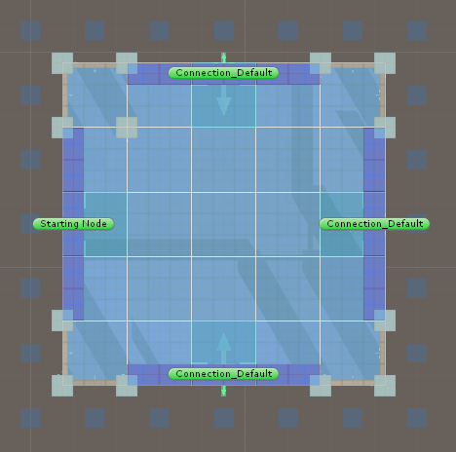
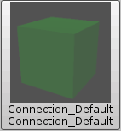
Connections in Editor
Starting node
Zero or one
Inner direction
Connections
Any amount
Outer direction
The connection of “A volume” will stick with the starting node of “B volume”, according to their direction of arrow. If doesn’t exist any stating node, will pick one connection randomly.

Slide 37
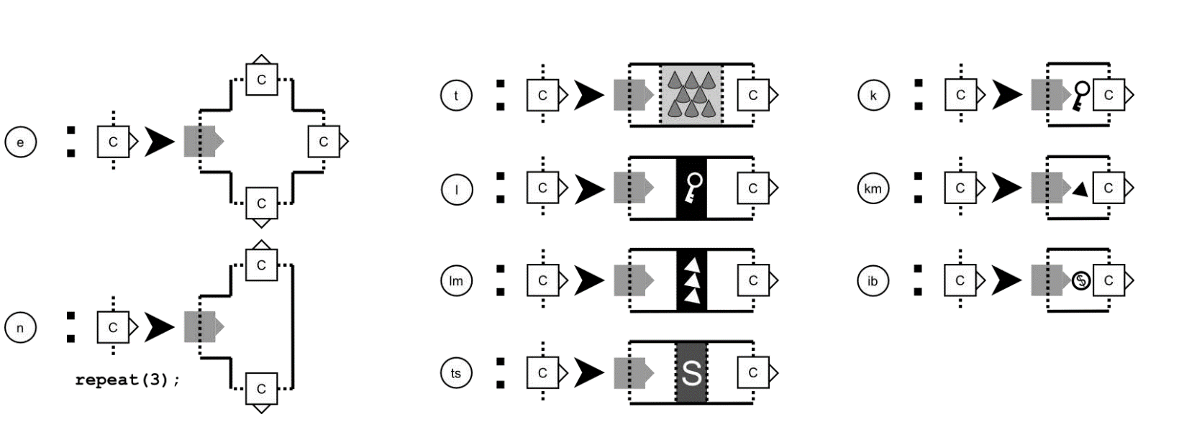
Instruction of Rewrite System
Building Instructions
Each rule in the shape grammar was associated with a terminal symbol form in the mission grammar.
Look for rules that implement that symbol, selects one at random based on their relative weight.
圖片 需更換

Slide 38
Replacement of Rewrite System

Slide 39
Genetic Algorithm in Segments Evolution
Genetic Algorithm
Algorithm flow
Gene
Crossover
Mutation
Nine fitness functions
Neglected
Block
Intercept
Patrol
Guard
Dominated
Support
Cover
Trap

Slide 40
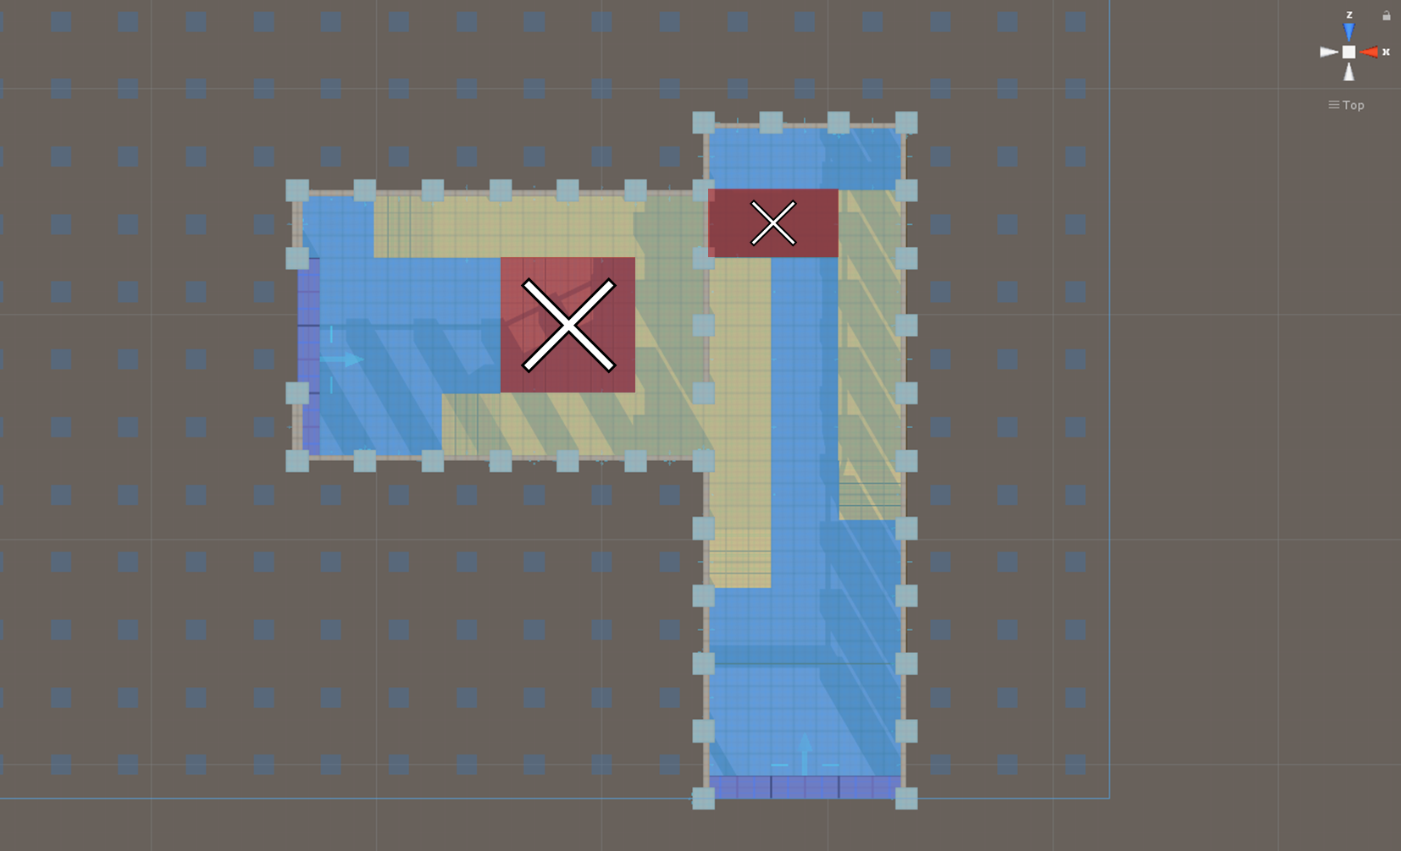
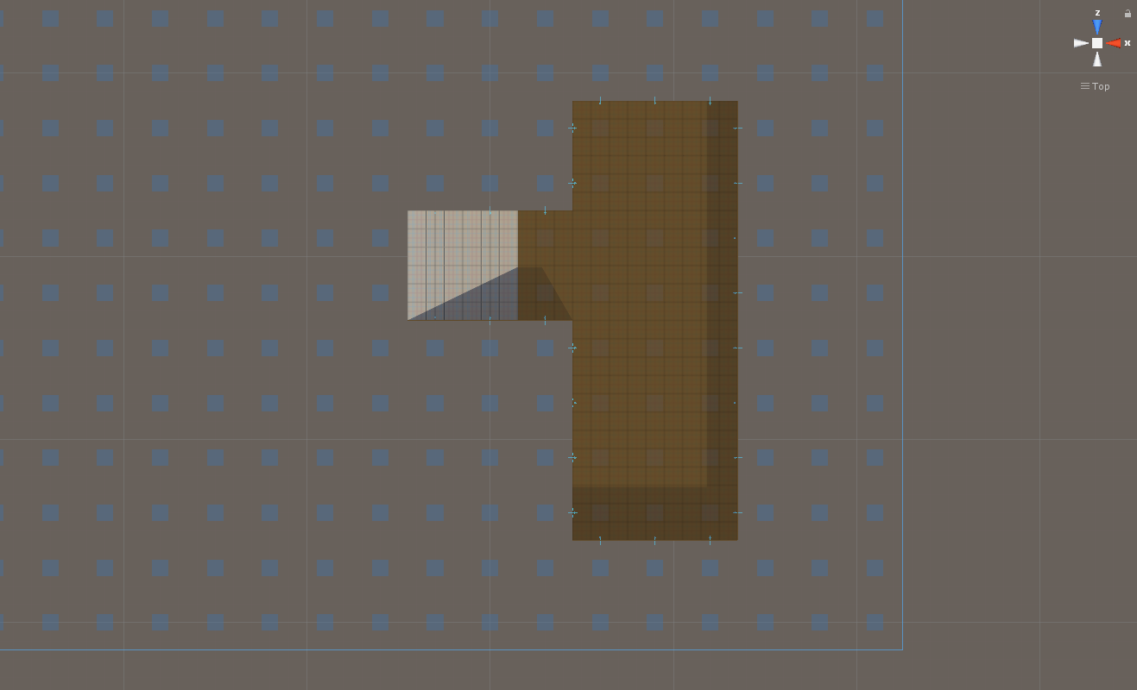


Gene
~
Basement
Gene Type
 | Empty
 | Enemy
 | Treasure
 | Trap
Gene
Ground
Individual (chromosome)
population

Slide 41
Crossover

Slide 42
Mutation

Slide 43
Nine fitness functions – 1st Neglected

Slide 44
Nine fitness functions – 2nd Block

Slide 45
Nine fitness functions – 3rd Intercept

Slide 46
Nine fitness functions – 4th Patrol

Slide 47
Nine fitness functions – 5th Guard

Slide 48
Nine fitness functions – 6th Dominated

Slide 49
Nine fitness functions – 7th Support

Slide 50
Nine fitness functions – 8th Cover

Slide 51
Nine fitness functions – 9th Trap

Slide 52
Experimental Results

Slide 54
Conclusions and Contributions

Slide 55
Conclusions

Slide 56
Contributions

Slide 57
Future Work

Slide 59
